Slide 1


DEPARTMENT OF COMPUTER SCIENCE AND ENGINEERING
20CS8504 & PROJECT WORK
END SEMESTER PRACTICAL EXAMINATION- APRIL / MAY - 2026
Batch No: 1
Date: 30.3.2026
Session: FN

Slide 2
Predictive Monitoring of AI-Generated Healthcare Content Saturation and Misinformation Risk
Guide Name:
Mrs. SATHYA R , M.E.,(Ph.D.,)
Assistant Professor
Department of CSE
Team Members:
SHUTHIKA K (811722104148)
SRIDARSENI K P (811722104152)
SWETHA M (811722104166)

Slide 3
OBJECTIVE OF THE PROJECT
1. To design a system that automatically analyzes online healthcare articles and determines their credibility.
2. To identify potential medical misinformation and detect whether the content may be AI-generated using advanced analysis techniques.
3. To assist users in verifying the reliability of healthcare information and reducing the spread of misleading medical content online.

Slide 4
INTRODUCTION
1. The rapid growth of online healthcare articles has made it difficult for readers to identify reliable and accurate medical information. Many sources publish unverified health claims that can spread misinformation.
2. Advancements in artificial intelligence technologies have enabled automated tools to generate large volumes of medical content that may appear authentic but may contain inaccurate or misleading information.
3. An automated system is proposed to analyze healthcare news articles and evaluate their credibility.
4. The system uses Natural Language Processing (NLP) and Machine Learning to extract medical entities, detect misinformation patterns, and identify AI-generated content.
5. By providing credibility scores, summaries, and risk indicators, the system helps users quickly assess the reliability of online medical information.

Slide 5
LITERATURE SURVEY
TITLE OF PAPER | AUTHOR(S) | TECHNOLOGY USED | PROS | CONS
An Explainable AI Framework for Artificial Intelligence of Medical Things | Al Amin, Kamrul Hasan, Saleh Zein-Sabatto, Deo Chimba, Imtiaz Ahmed, Tariqul Islam | CNN, Ensemble Learning, SHAP, LIME, Grad-CAM Explainable AI | Improves Transparency in Medical AI | Complex Model Implementation
Automatic Detection of Health Misinformation: A Systematic Review | S. Swire-Thompson | Machine Learning, Text Mining, NLP-based misinformation detection | Identifying health misinformation on digital platforms. | Mking performance comparison difficult
Explainable Artificial Intelligence in Healthcare: Algorithms and Clinical Integration | Kagaba J. Bosco, Q. Hugh Li | SHAP, LIME, Attention- based Deep Learning | Improves Transparency in AI Models | Computational Complexity
Distinguishing Reality from AI: Approaches for Detecting Synthetic Content | David Ghiurau, Daniela Popescu | Generative AI Detection, Transformer Models, Synthetic Content Analysis | Effective Detection of AI- Generated Content | Detection Becomes Harder as AI Improves
Detection and Classification of Fake News Using NLP and Deep Learning | P. K. Sharma, Manvendra Singh Divakar, Ritu Lodhi | Deep Learning, NLP, Text Feature Extraction | Deep learning models improve detection accuracy. | Requires significant training data and processing resources.

Slide 6
TITLE OF PAPER | AUTHOR(S) | TECHNOLOGY USED | PROS | CONS
Self-Explainable AI for Medical Image Analysis: A Survey | Junlin Hou, Sicen Liu, Yequan Bie, Hongmei Wang | Self-Explainable Deep Learning, Attention Models, Explainable Neural Network | Improves model transparency by integrating explanations directly into AI models | Self-explainable models can be computationally complex
Detecting Health Misinformation in Social Media Using Machine Learning | K. Sharma, S. Qian, H. Jiang | NLP, SVM, Random Forest, Text Classification | Analyzes large volumes of social media data efficiently. | Detection accuracy depends on quality and size of the dataset
Transformer-Based Fake News Detection for Healthcare Applications | Y. Liu, M. Chen | BERT, Transformer Models, Deep Learning | Captures context and semantic meaning in healthcare news. | Performance may drop with new or unseen misinformation
Fake News Detection Using NLP | Akintya Nigam,Aradhya Dhruv | Natural Language Processing (NLP), Machine Learning, Text Classification | Helps identify fake or misleading information in digital media. | Performance depends heavily ondataset quality.
AI-Based Fake News Detection Using NLP | Omkar Reddy Polu | Artificial Intelligence, Natural Language Processing, Machine Learning | Effective for analyzing large volumes of online content. | AI models may misclassify complex or ambiguous statements.

Slide 7
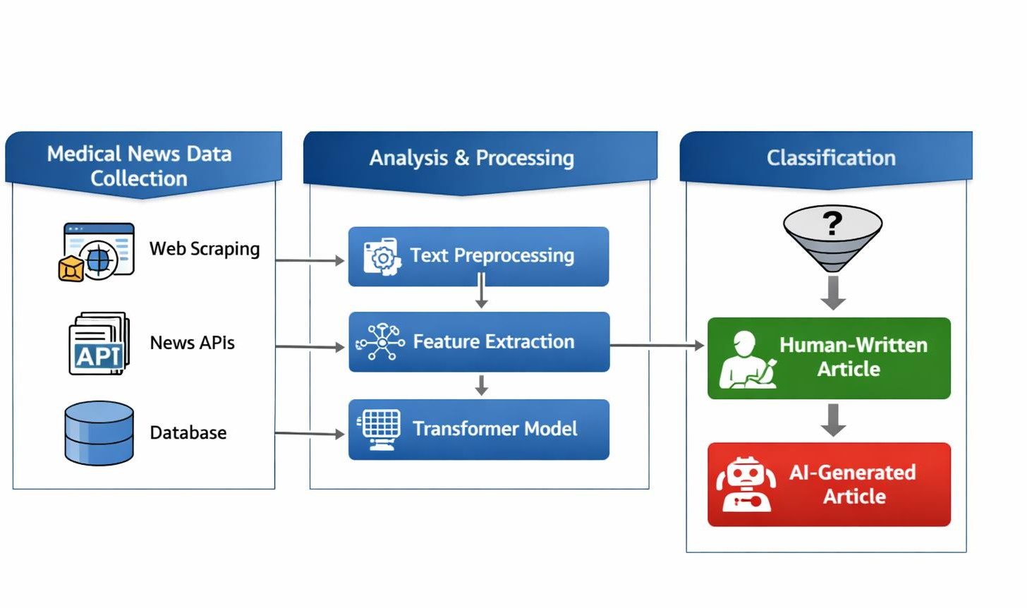
EXISTING SYSTEM ARCHITECTURE

Slide 8
PROBLEM IDENTIFIED
1. The rapid growth of Generative AI tools has increased AI-generated healthcare content such as medical articles advice, and online health information.
2. AI can produce content quickly, but it may include incorrect, outdated, or misleading medical information, affecting public health awareness.
3. The large volume of AI-generated content can cause content saturation, where synthetic information overshadows verified medical knowledge.
4. Current healthcare monitoring systems mainly detect general misinformation but cannot effectively identify AI- generated medical content or measure its saturation.
5. There is a lack of predictive systems to forecast the growth of AI-generated healthcare content and evaluate its potential misinformation risk.
6. An intelligent AI-based system is developed to automatically analyze healthcare articles, detect AI-generated content, identify suspicious medical claims, and calculate a credibility risk score to help users evaluate the reliability of online healthcare information and reduce the spread of medical misinformation.

Slide 9
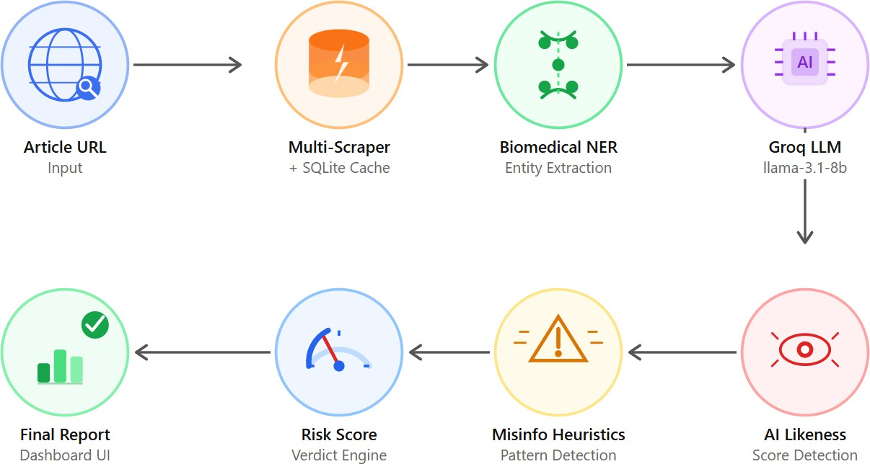
PROPOSED SYSTEM ARCHITECTURE

Slide 10
SOFTWARE AND HARDWARE REQUIREMENTS
HARDWARE
1. Processor: Intel Core i5 or higher
2. RAM: Minimum 8 GB
3. Storage: 256 GB Hard Disk / SSD
SOFTWARE
1. Operating System: Windows / Linux
2. Programming Language: Python, HTML, CSS, JavaScript
3. Development Tools: VS Code with ML libraries (FastAPI, Transformers, PyTorch, BeautifulSoup, Trafilatura)

Slide 11
MODULES
1. User Interface Module
2. Data Collection Module
3. Text Preprocessing Module
4. Medical Claim Detection Module
5. AI-Content Detection Module

Slide 12
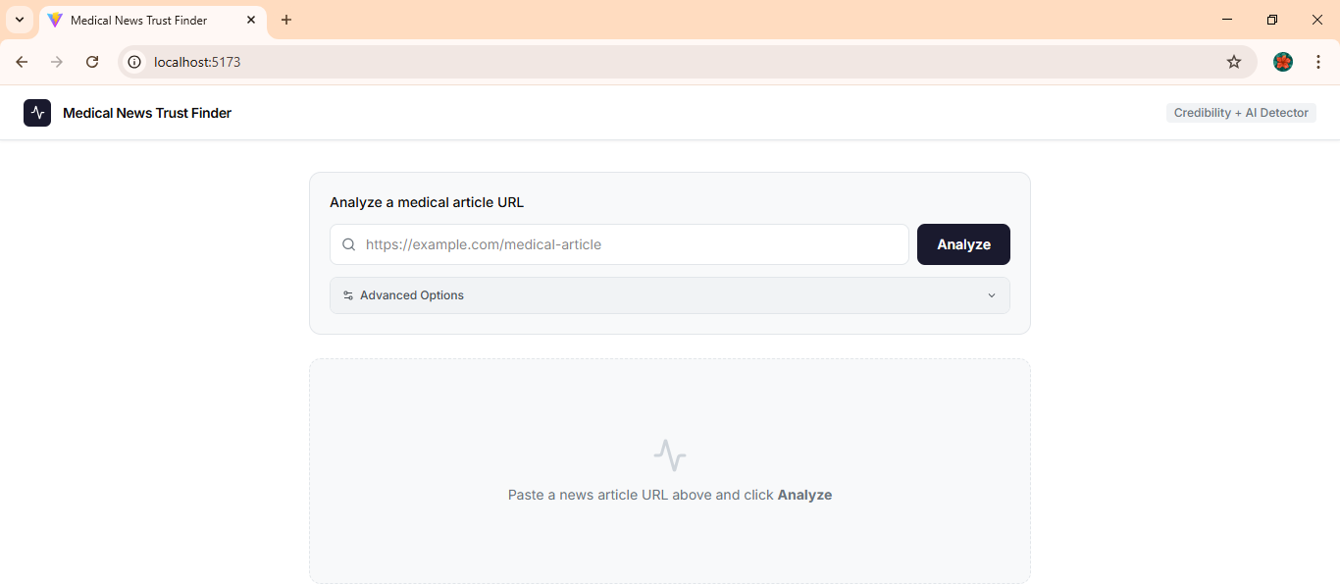
MODULE-1
User Interface Module
Allows users to enter or submit a healthcare news article URL for analysis.
Displays the analysis results such as credibility score, detected medical claims, and AI-generated content probability.
Screenshot of Module - 1

Slide 13
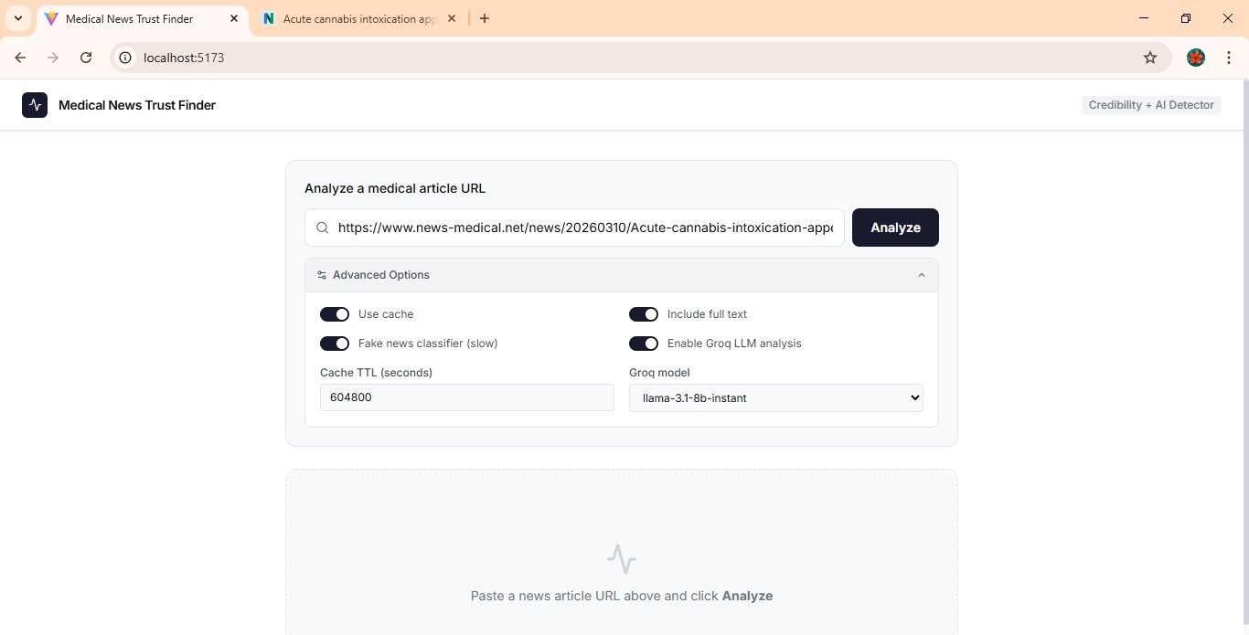
MODULE-2
Data Collection Module
Retrieves healthcare article content from the provided URL using web scraping techniques.
Extracts and stores the main text of the article for further analysis.
Screenshot of Module - 2

Slide 14
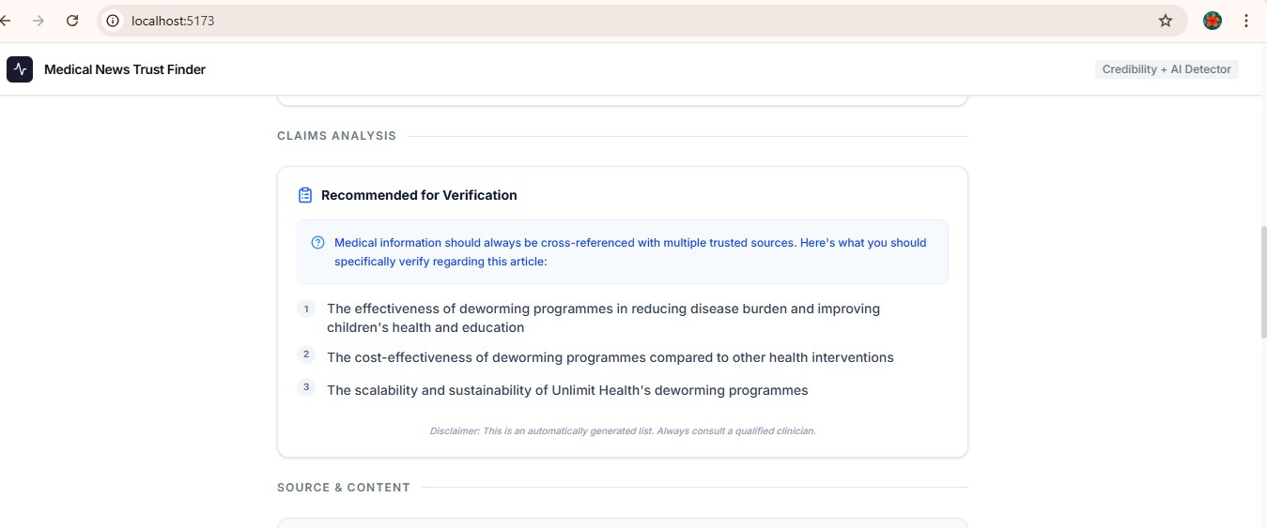
MODULE-3
Text Preprocessing Module
Cleans the extracted article text by removing HTML tags, special characters, and unnecessary content.
Converts the text into a structured format suitable for Natural Language
Processing (NLP) analysis.
Screenshot of Module - 3

Slide 15
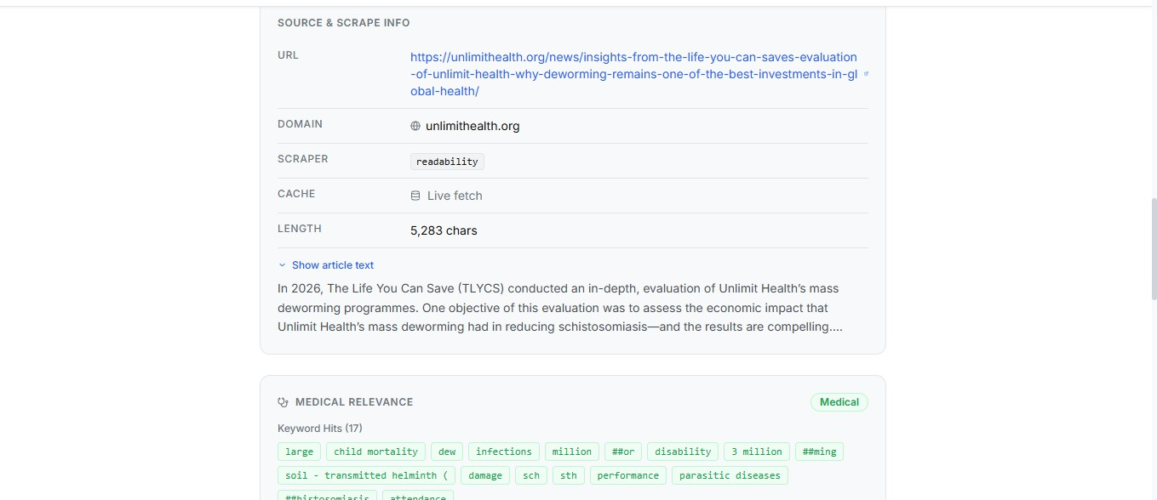
MODULE-4
Medical Claim Detection Module
Identifies medical entities such as diseases, treatments, drugs, and symptoms mentioned in the article.
Detects suspicious or misleading health claims that may indicate misinformation.
Screenshot of Module - 4

Slide 16
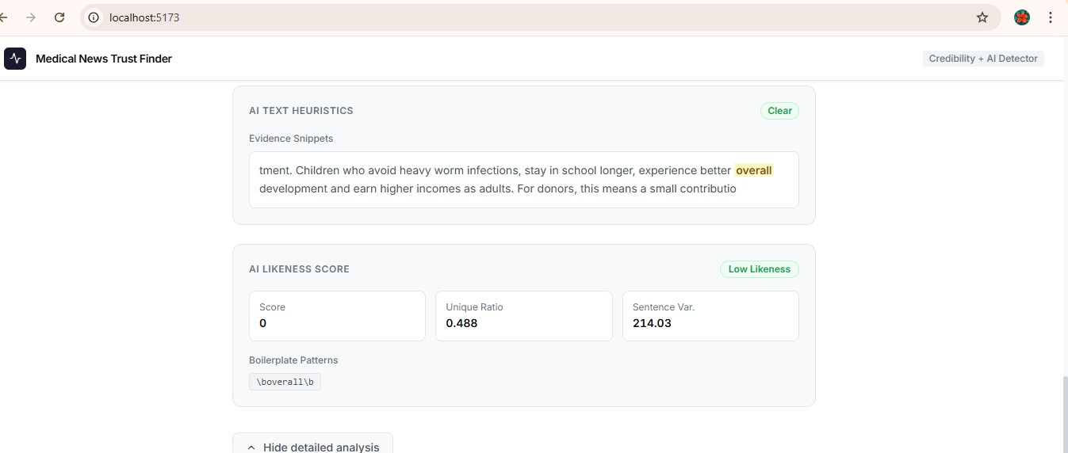
MODULE-5
AI Content Detection Module
Analyzes writing patterns and linguistic features to identify whether the article may be AI-generated.
Estimates the probability of AI-generated content and flags potentially automated health articles.
Screenshot of Module - 5

Slide 17
CONCLUSION
In conclusion , the project successfully developed an AI-based system that analyzes healthcare articles to detect medical misinformation and identify AI- generated content, helping users evaluate the credibility of online health information.
By combining web scraping, Natural Language Processing (NLP), and machine learning techniques, the system provides reliable insights that help reduce the spread of misleading healthcare content on the internet.

Slide 18
FUTURE ENHANCEMENTS
Detection of Multimodal Health Misinformation
Future systems can analyze not only text but also images and videos to identify misleading visual health information using multimodal deep learning.
2. Multi-Language Medical Content Analysis
The system can be enhanced with multilingual NLP to detect misinformation in medical articles written in languages like Tamil, Hindi, Telugu, and other regional languages.

